Slide 1

ISSS616 Applied Statistical Analysis with R
Statistical insight and analysis on
Los angeles crimes rates
2020 - 2021
Group 6
Antonius Handy
Jonathan Yang Zixian
Ng Wee Kien
Mike Phan Tuan Minh
Widya Tantiya Yutika

Slide 2
Agenda
INTRODUCTION
DATA PREPARATION
ANALYSES & INSIGHTS
SHINY DEMO
RECOMMENDATION
FUTURE WORK

Slide 3
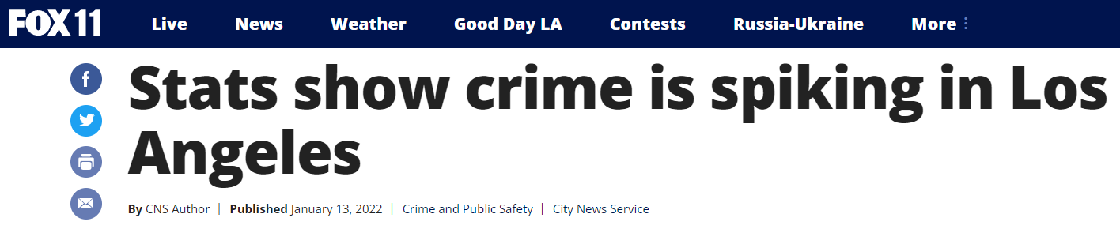
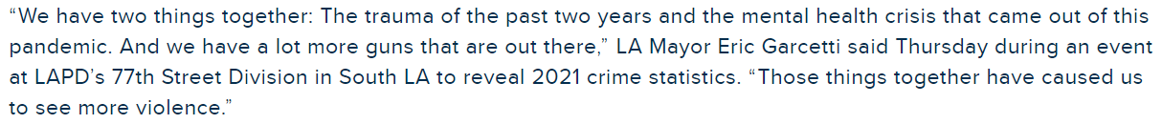
INTRODUCTION
There has been some news about the increasing crime rates in LA
Objective:
To provide insights on crime patterns in LA over the past two years
To confirm the validity of the news

Slide 4

DATA PREPARATION
The dataset was provided by LAPD and extracted from Los Angeles’ open data website.
Data reflects incidents of crime in Los Angeles, transcribed from original crime reports, from the period 2020-2021.
Data Field | Description
DR_NO | Unique case number for each case incident
DATE_OCC, TIME_OCC | Date and time of crime incident
AREA | Area code and name of police station responding to the crime incident
Part 1-2 Crm_Cd_Category | Classification of crime incident
Vict Age, Sex, Descent | Descriptions of the victim by age, gender and ethnicity
Premis Cd Premis Desc | Code and description of the premise of the crime
Weapon Used Cd Weapon Desc | Type of weapon used in the crime
LAT LON | Longitude and latitude of location of crime

Slide 5
TOTAL CRIMES REPORTED FROM 2020 – 2021 & CRIME TYPES SPLIT
205,578
3.8%
198,020
2020
2021
There is an increase of 3.8% in the total number of crimes reported in 2021 compared with 2020
Crimes are categorized into 3 main categories: Property (theft, burglary, robbery…), Violent (gun, assault, battery, arson…) and Others

Slide 6
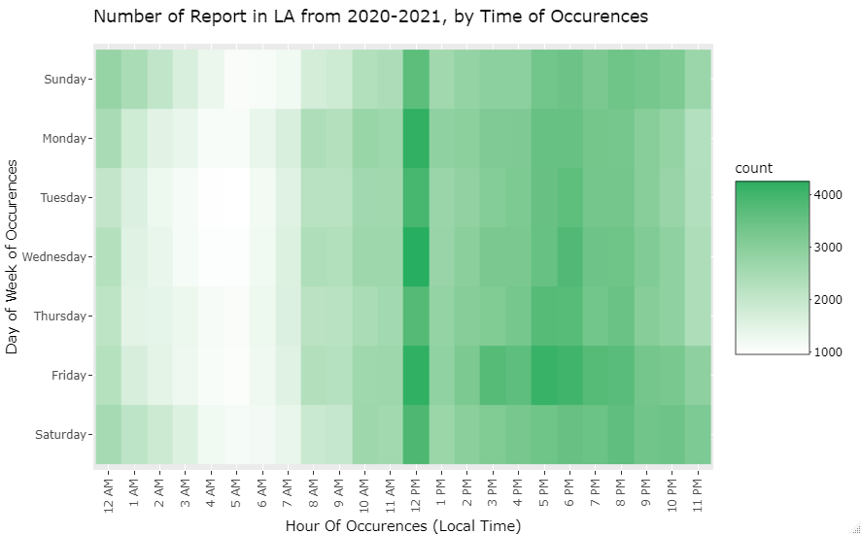
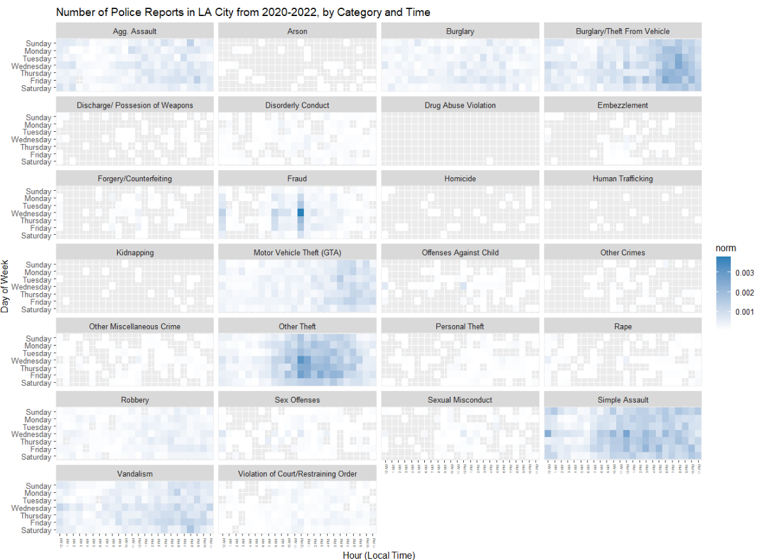
HEAT MAP OF CRIME OCCURENCE

Slide 7
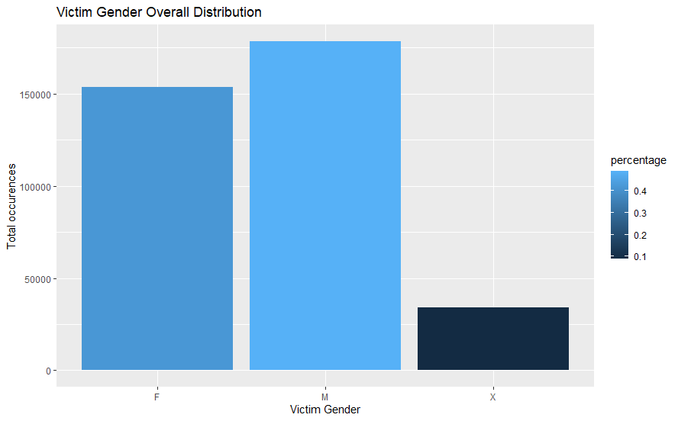
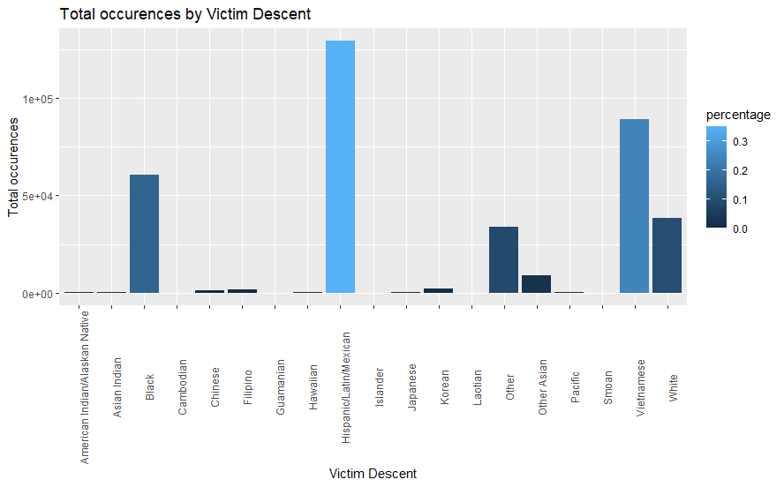
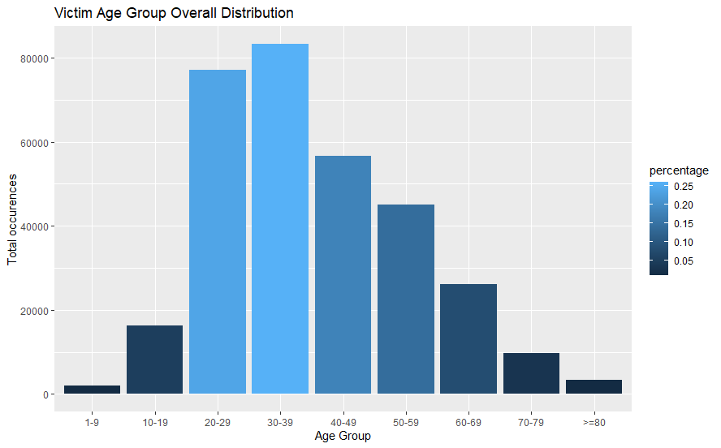
Victim Demographics

Slide 8
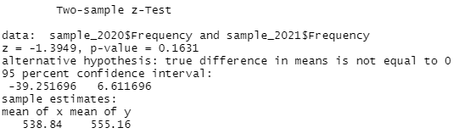
Hypothesis Testing
Is there is a difference in daily crime rates between 2020 and 2021?
Null hypothesis H₀: There is no difference in daily crime rates between both years
Alternative hypothesis H₁: There is a difference in daily crime rates between both years
Results: Since p-value exceeds significance level of 0.05, we are unable to reject the null hypothesis. There is insufficient evidence to conclude that there is a significant difference in daily crime rates between 2020 and 2021.
Notes:
Hypothesis testing can be used by the LAPD to gauge the effectiveness of their crime prevention strategies, by comparing crime rates year on year.
There is insufficient evidence to conclude that there is a difference in crime rates between both years.
This is interesting because:
Despite the increase in number of crimes reported, there was no statistical evidence to conclude that crime rates have increased
Crime never sleeps – crime rates remained constant despite 2020 being a COVID lockdown year compared to 2021

Slide 9
Confidence Interval
CI: 558-569
CI: 535-547
95% Confidence Interval of daily mean crime incidents in 2020 vs 2021
Notes:
We were also able to construct a 95% confidence interval on the daily average crime incidents in 2020 vs 2021.
This CI can be useful for LAPD to gauge the number of crime incidents happening per day in LA and assist with police manpower allocation for crime prevention.

Slide 10
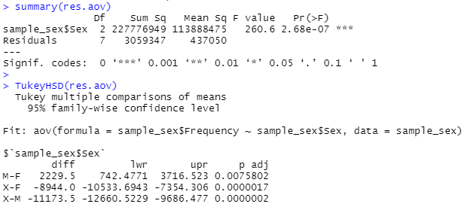
Anova test
Is there a difference in mean monthly crime rates across different genders?
Null hypothesis H₀: There is no difference in mean between different genders
Alternative hypothesis H₁: There is a difference in mean between different genders
Results: Since p-value is smaller than significance level, we can reject the null hypothesis. We performed the Tukey test subsequently, which showed that crime victims are more likely Male > Female > X
Notes:
We wanted to understand whether there was any difference in average monthly crime rates towards different gendered victims.
We then further performed the Tukey test to understand which means are significantly different from each other. The results showed that men were more likely to be victim of crimes as compared to females.
This ANOVA test can be further tested on the various victim demographic categories, and is useful for the LAPD to identify vulnerable communities or people that requires increased police protection.

Slide 11

Shiny app demonstration

Slide 12

Limitations
Scope
Data collected from 2 years, 2020 – 2021
Unable to observe data from 2019 and earlier, i.e. Pre-covid time
Geography
Data is only limited within LA area
Observation, insights and analysis are valid for reference only within LA area

Slide 13

recommendation
Total crime increased in 2021, but there is no significant difference in daily crime rates
Optimise manpower allocation according to popular days and time for crime occurrence, i.e. Wednesday 12PM
Identification of vulnerable communities and people for increased police protection, i.e. Hispanic/Latin male adults aged 30-39 years old
Identify crime hotspots for increased policing and potential relocation of police stations for faster response time
Understand varying trends of different crime types to formulate city’s crime prevention strategies

Slide 14

Future work
Supplement analysis with secondary sources of data (e.g. poverty rate, weather)
Regression model to predict likelihood of crime given certain parameters

Slide 15
Thank you! Q&A

